Slide 1
Web-based Health Care Management System for Children
BY
Bharadwaj Varma Chennamraju (0864476)

Slide 2
Implementation
Created Login page for Patients, Doctors and admin for which validation has been done.
Implemented “MyPortal” Page. => User can update his profile, book appointments and see appointment history.
Doctors can login to their portal update their profile and check available appointments
Admin can login to their portal manage patients, doctors, appointments and can also view the session logs for doctors and patients.
Implemented Resources page containing the information of common child health problems.

Slide 3
Development Tools
Language Used : PHP 5.62 (Developed in Core PHP)
Database : My SQL
User Interface Design : HTML, AJAX, JQUERY, JAVASCRIPT
Software : XAMPP Server

Slide 4
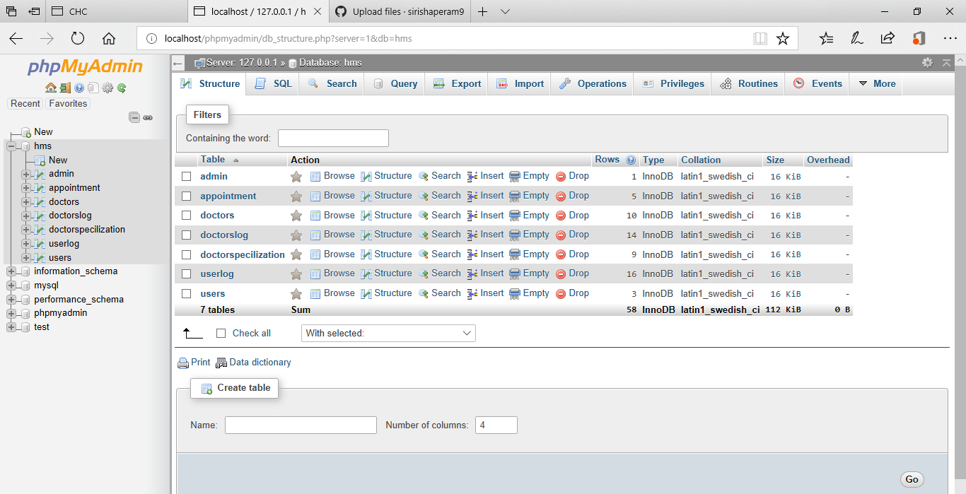
Database

Slide 5
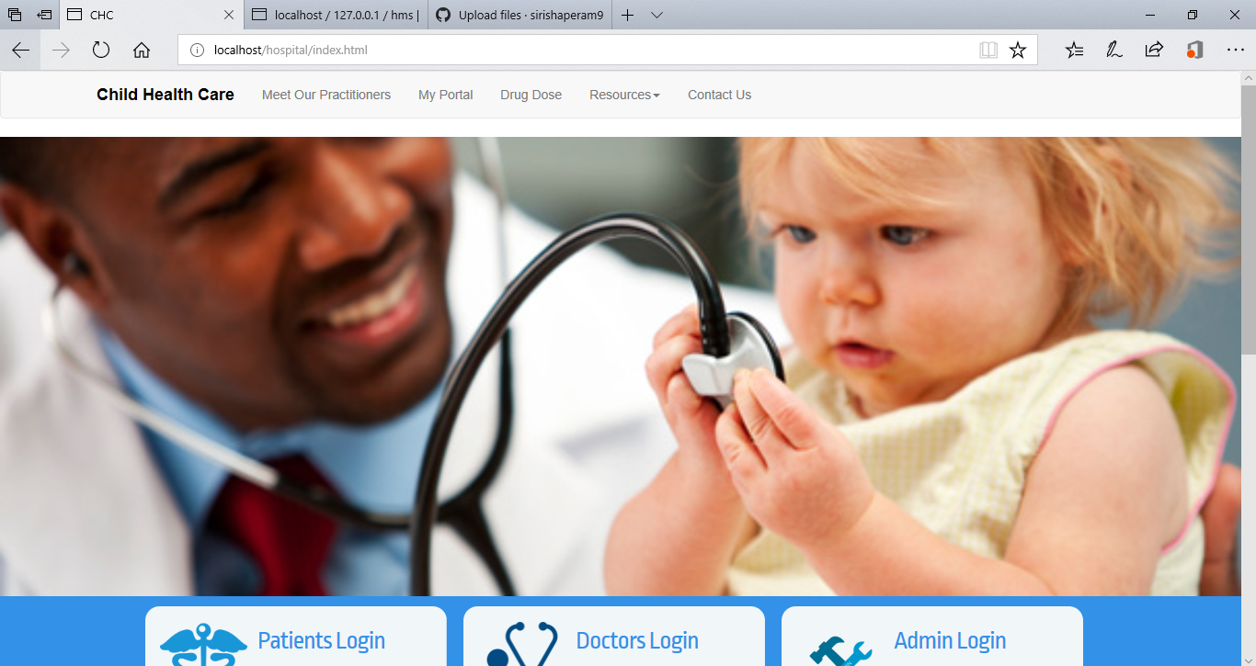
Home Page

Slide 6
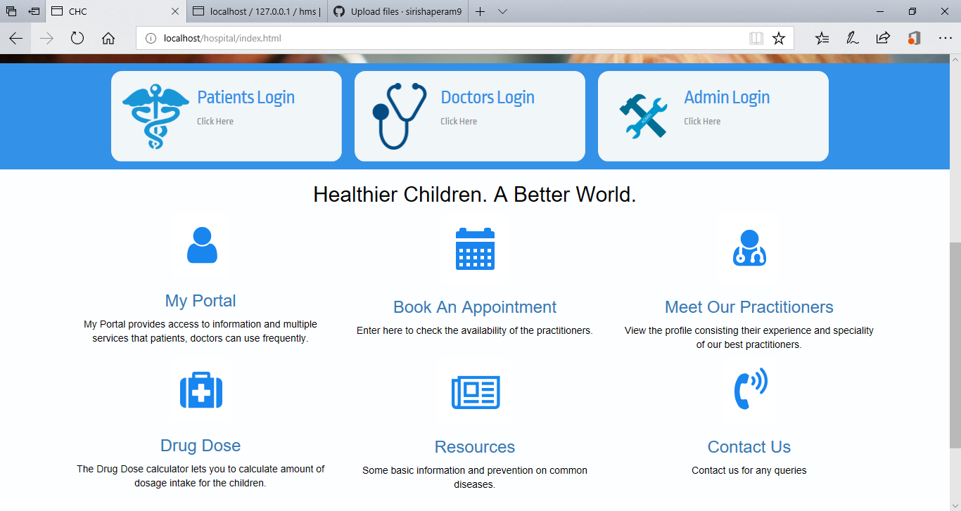
Home Page (Cont.)

Slide 7
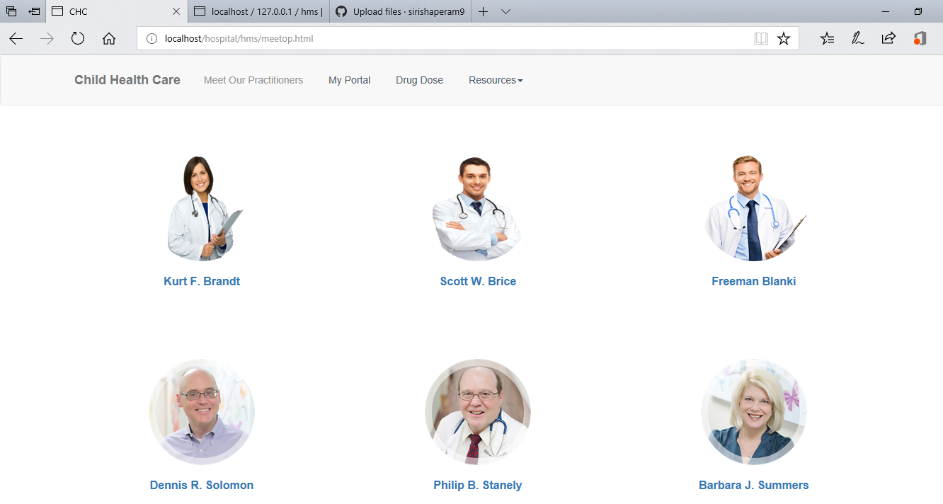
Meet Our Practitioners

Slide 8
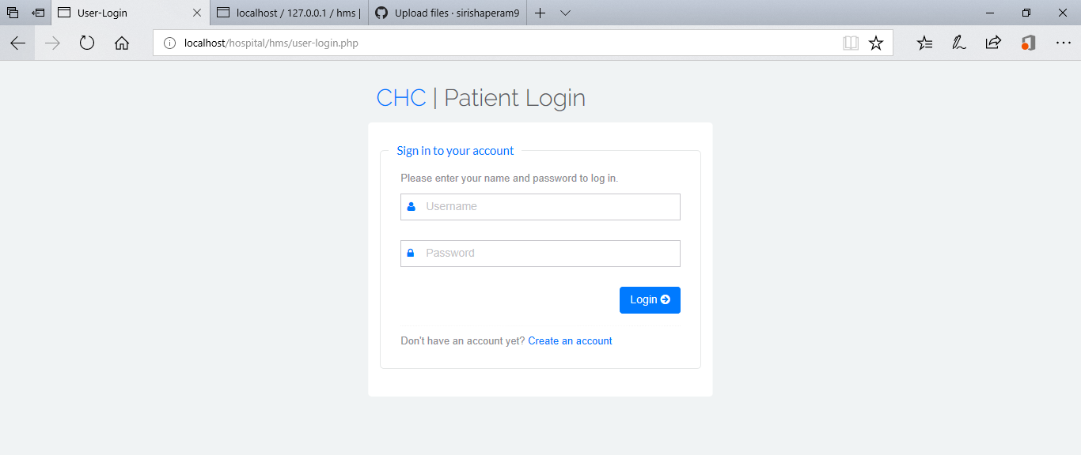
Patient Login Page

Slide 9
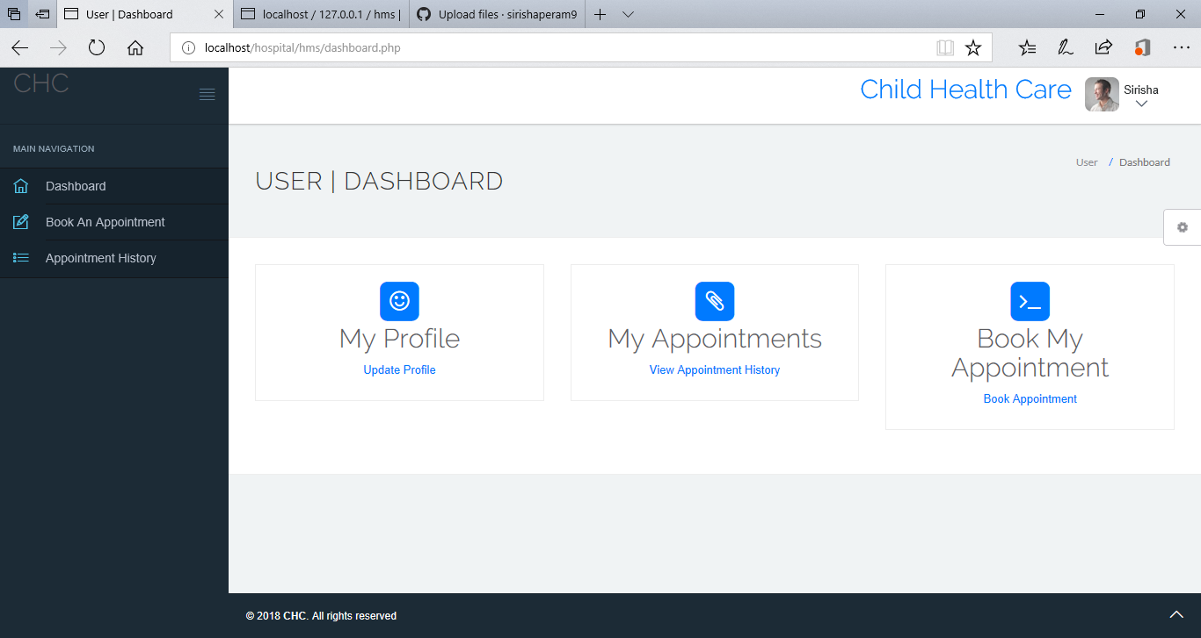
MyPortal: Patient

Slide 10
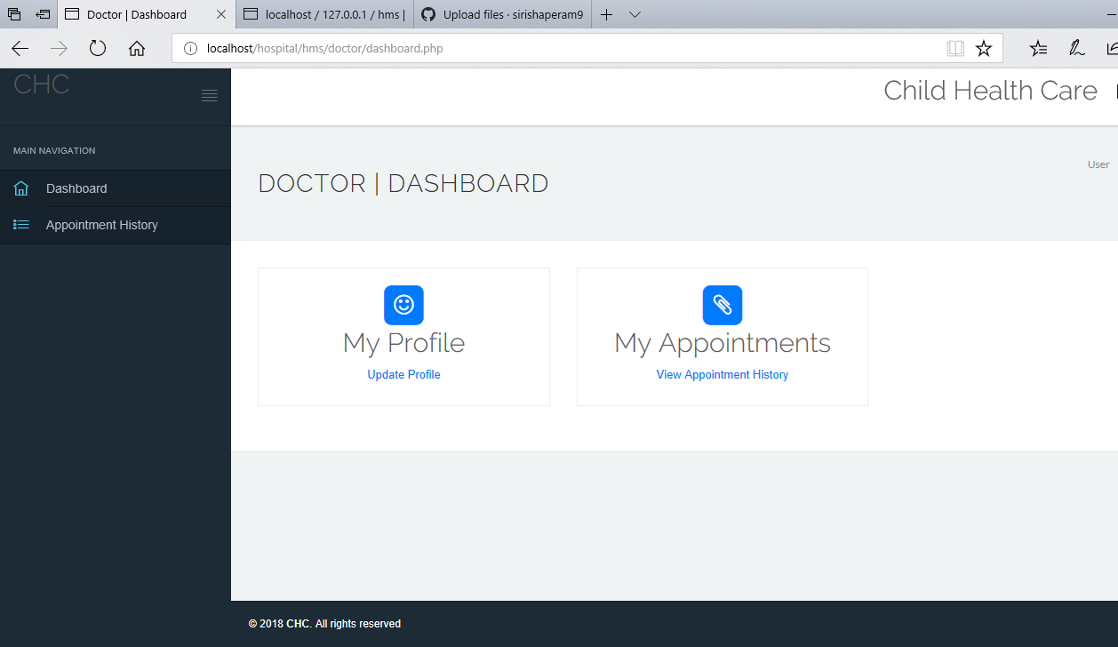
Doctor’s portal

Slide 11
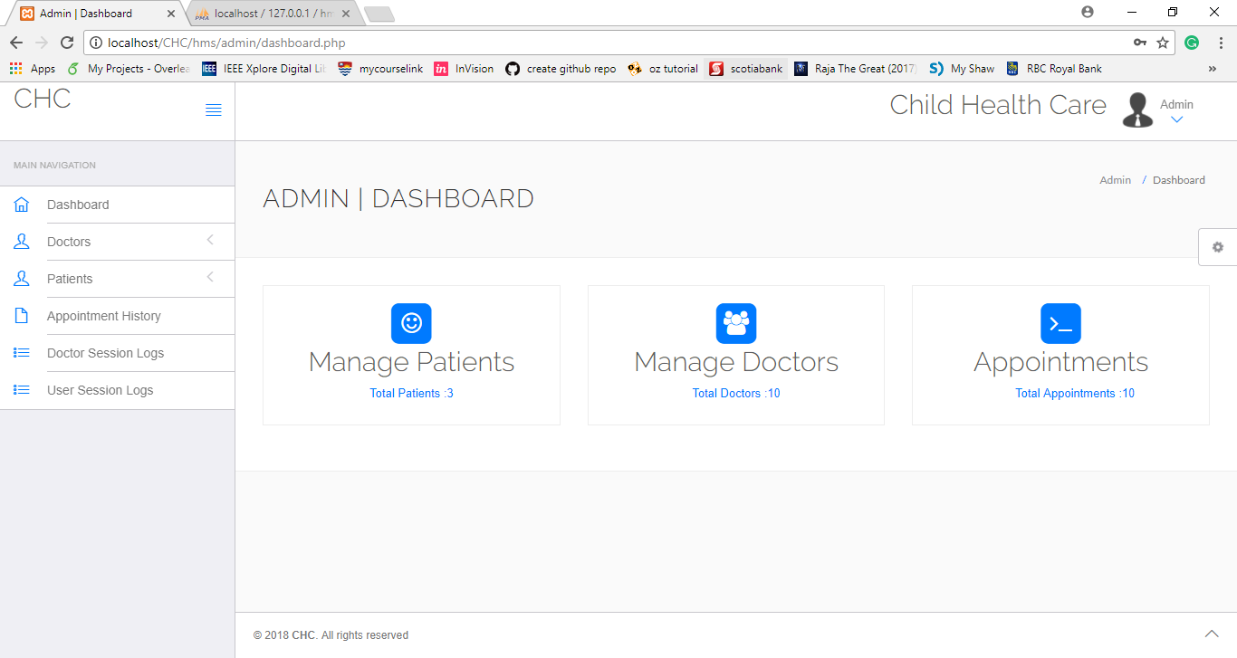
Admin’s Page

Slide 12
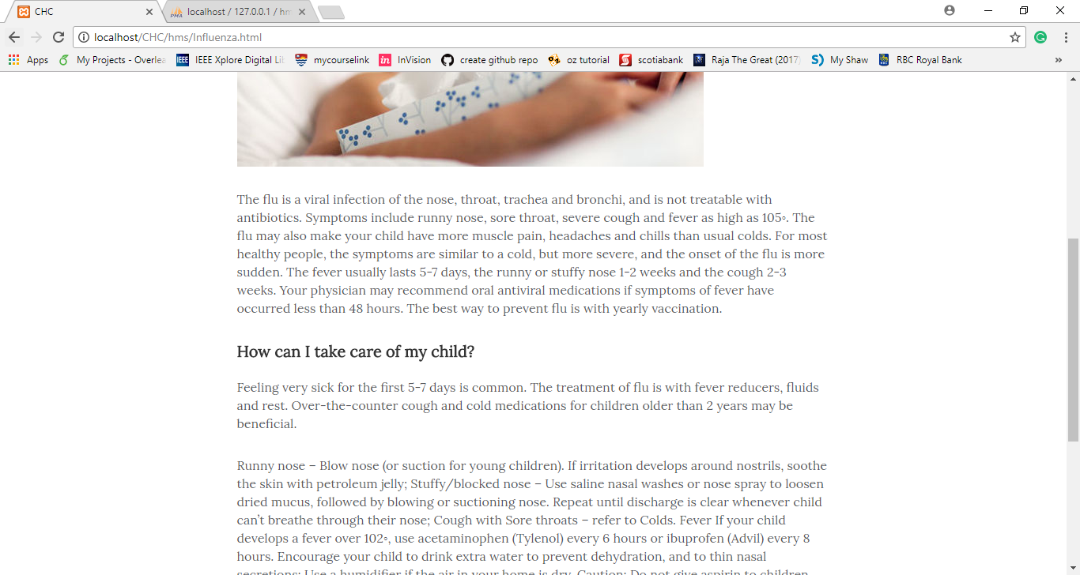
Resources page

Slide 13
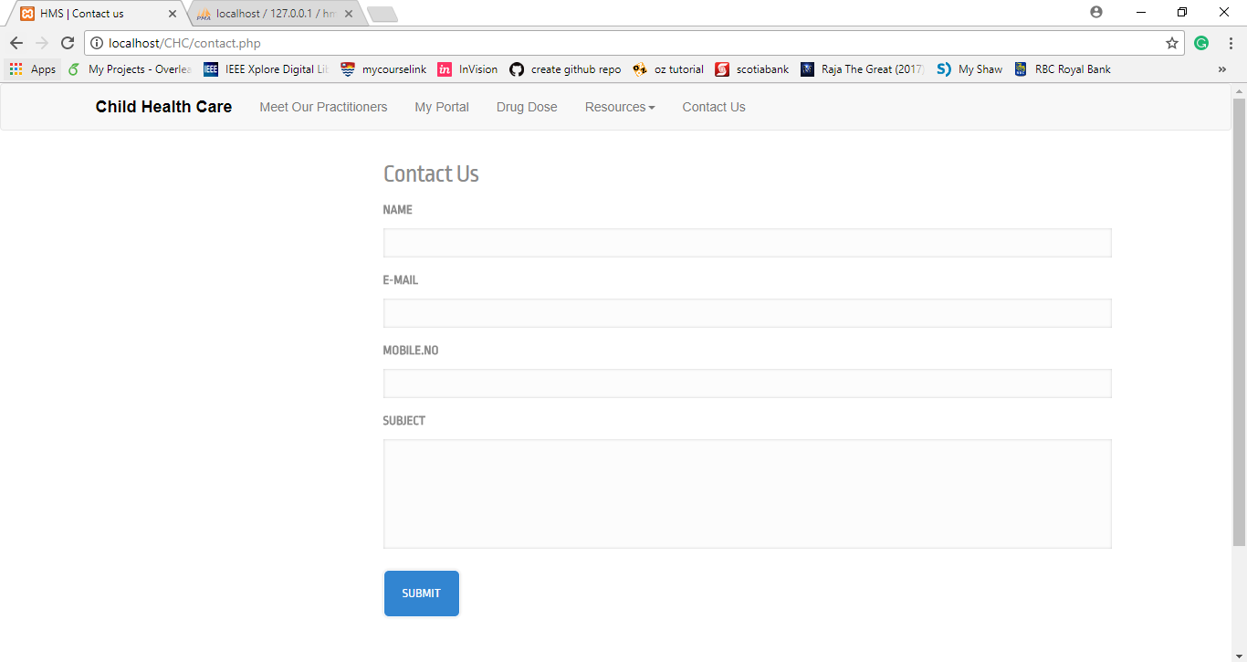
Contact us page

Slide 14
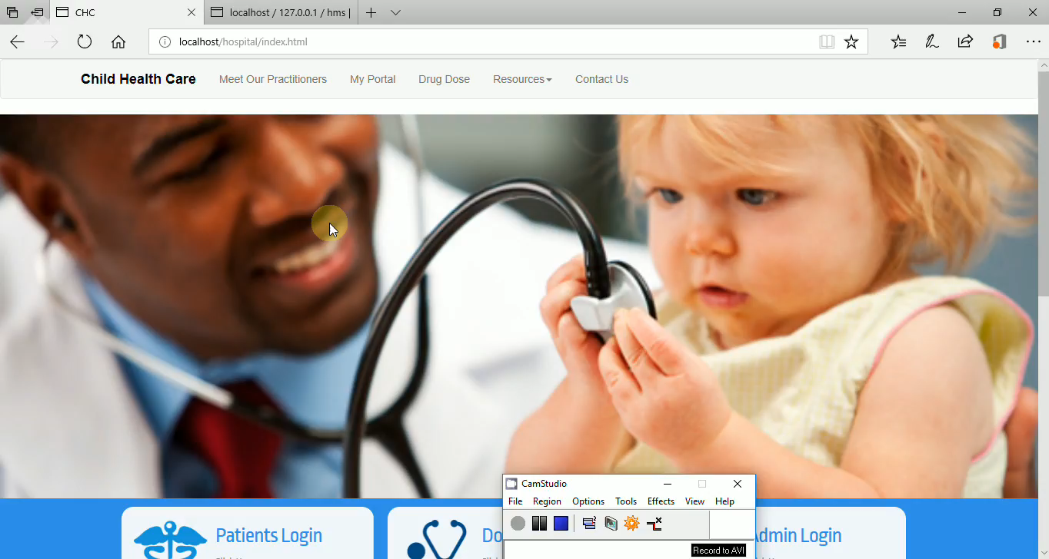
Demo

Slide 15
Future Work
A Drug Dose calculator to calculate the amount of dosage intake for children.
Doctors can upload the test results for their respective patients.
Also the reviews can be submitted for the doctors.

